Slide 1
TASK-3

Slide 2
REPORT
TITLE : Cross-site scripting
DOMAIN : vulnweb.com
SUBDOMAIN: testasp.vulnweb.com
DESCRIPTION: Cross-site scripting vulnerability was found on our website which creates an impact in stealing the credentials and sensitive information of the users.
PAYLOAD I USED: <script>alert(12345)</script>
STEPS I FOLLOWED:
1)I created a payload <script>alert(12345)</script> and then inserted this payload in search bar of website testasp.vulnweb.com
2) Then clicked search posts and then you can see that the payload inserted works.

Slide 3
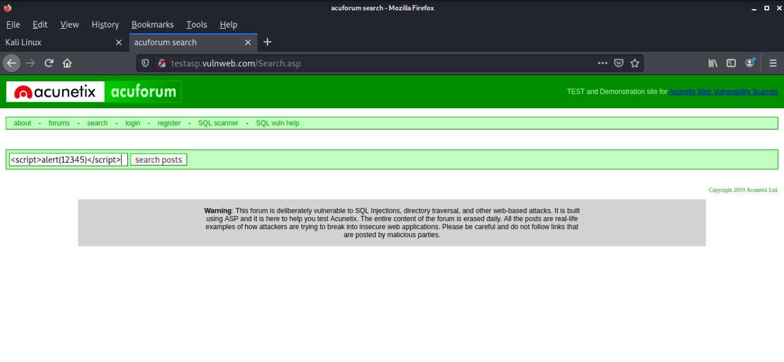
;
.
IMPACT :A hacker can find this vulnerability and can easily change any information related to user. And the hacker can have the complete access of the users computers by this vulnerability.
MITIGATION: Cross-site scripting attacks can be prevented by Specifying a charset and you need to HTML-escape all user inputs which include < with &lt, > with &gt etc.
POC:
;.

Slide 4
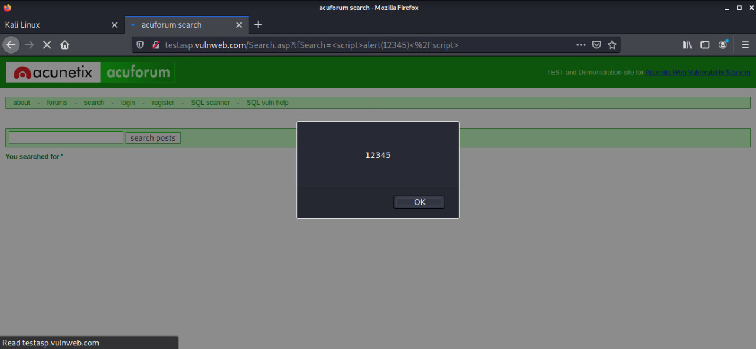

Slide 5
